Slide 1
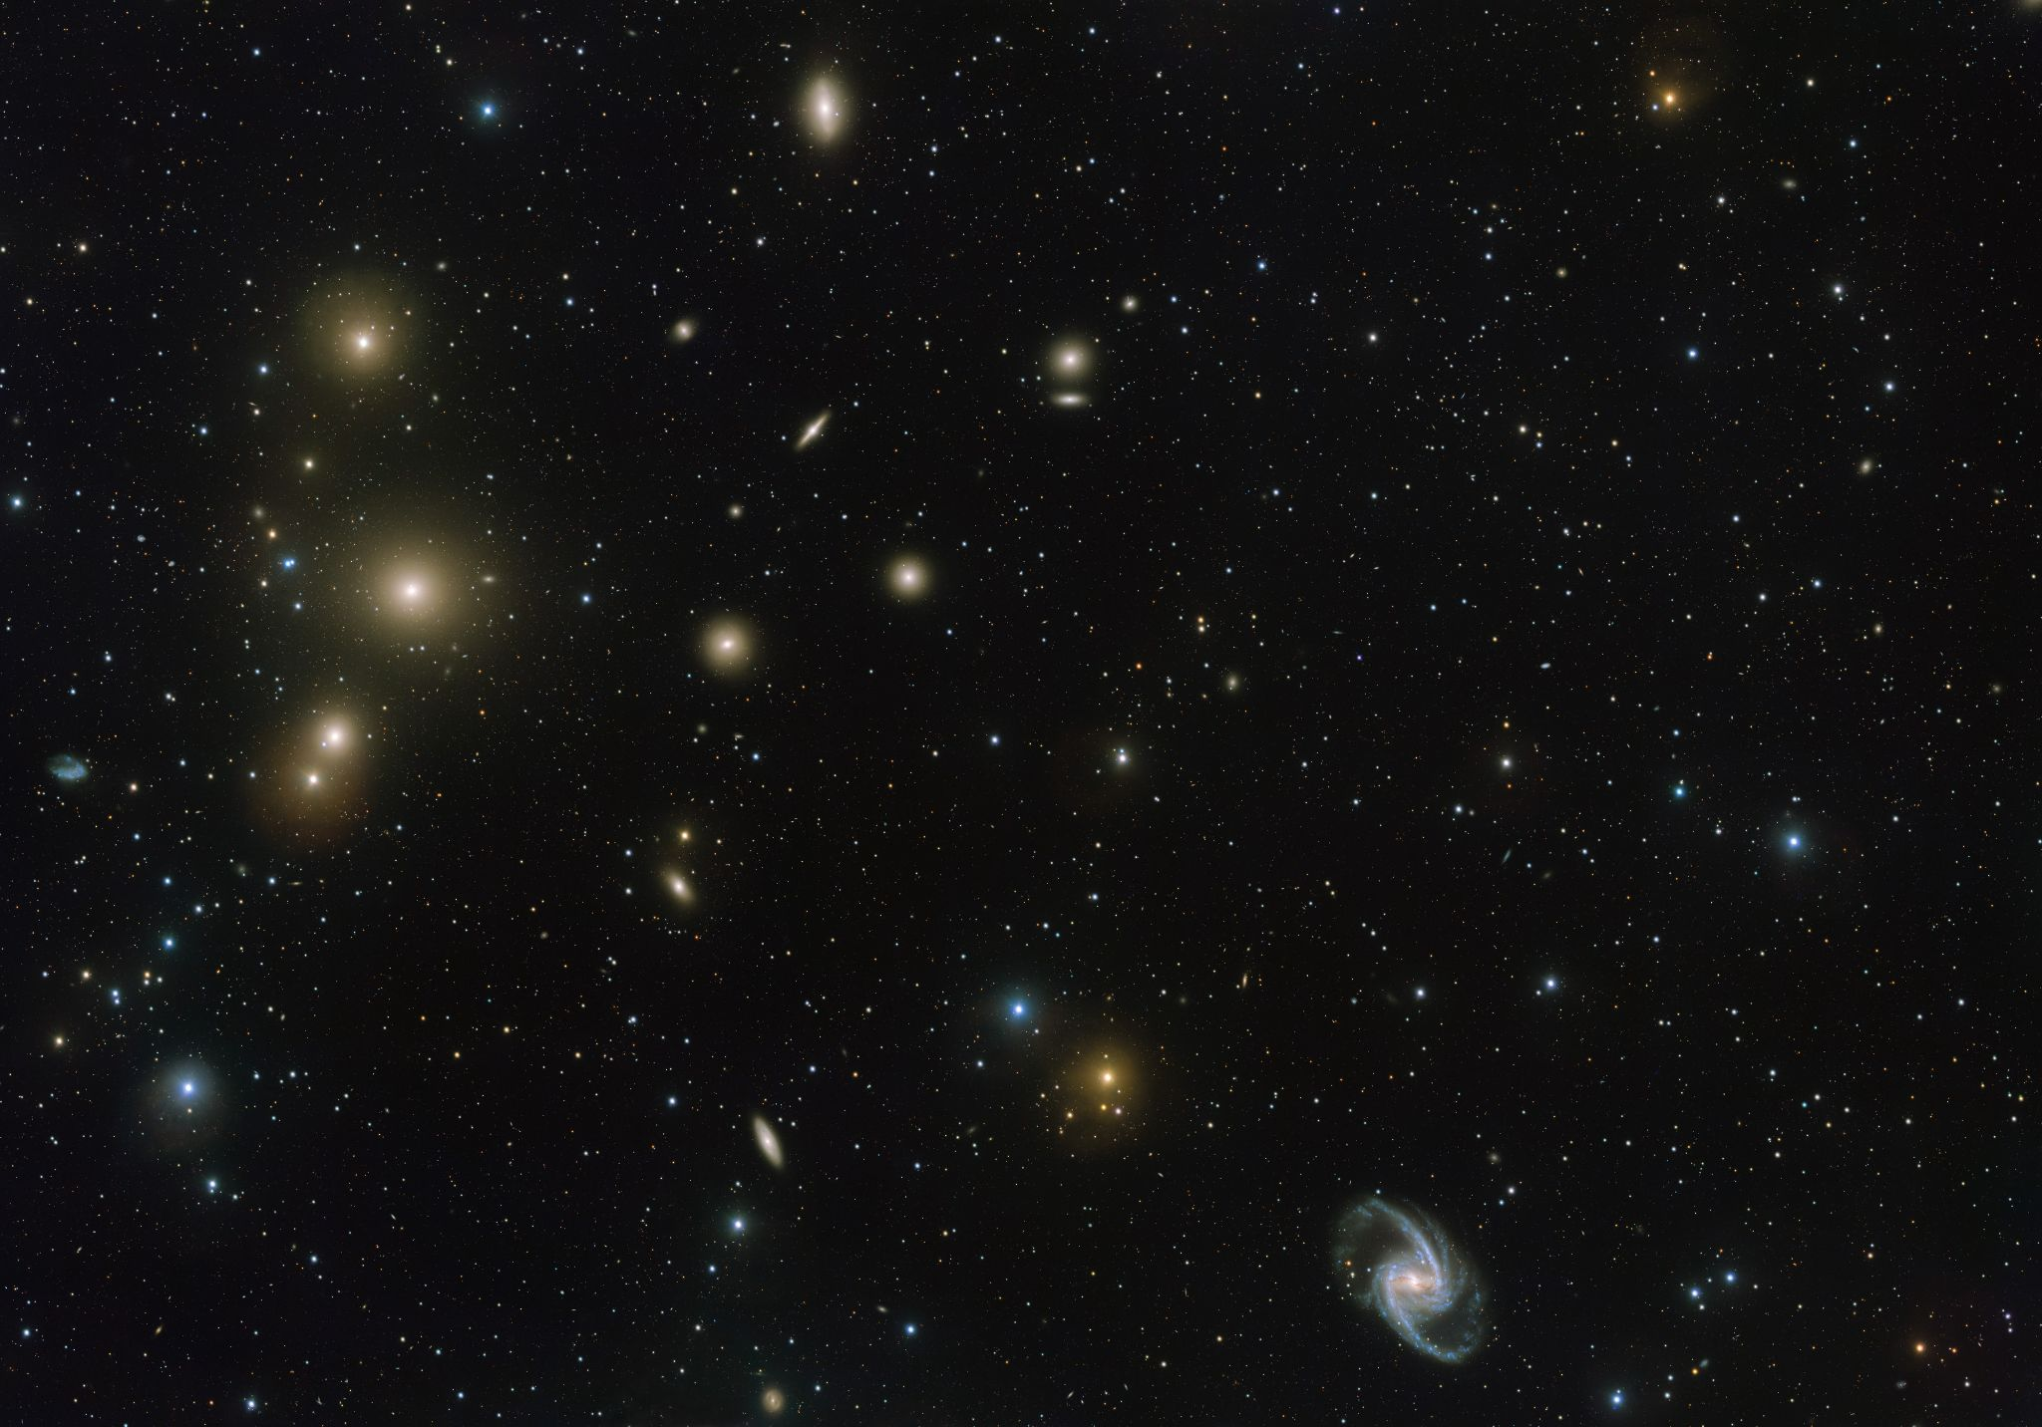
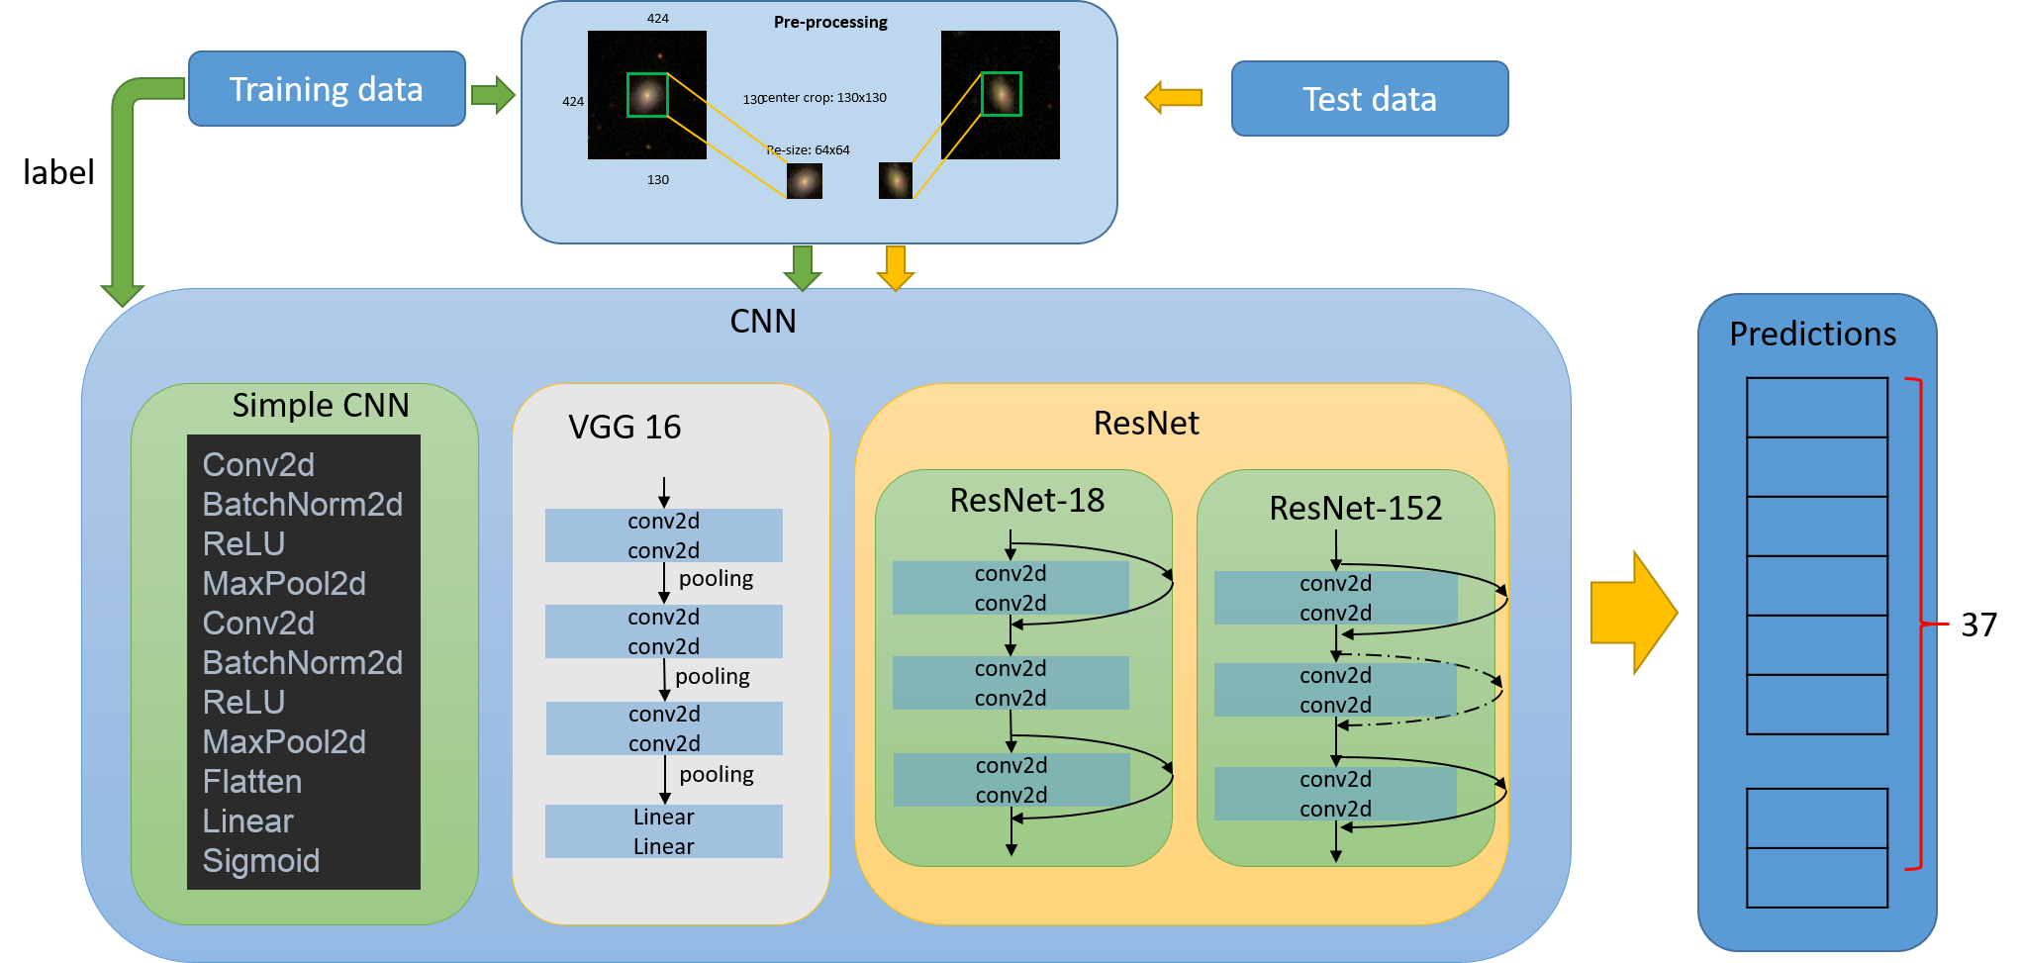
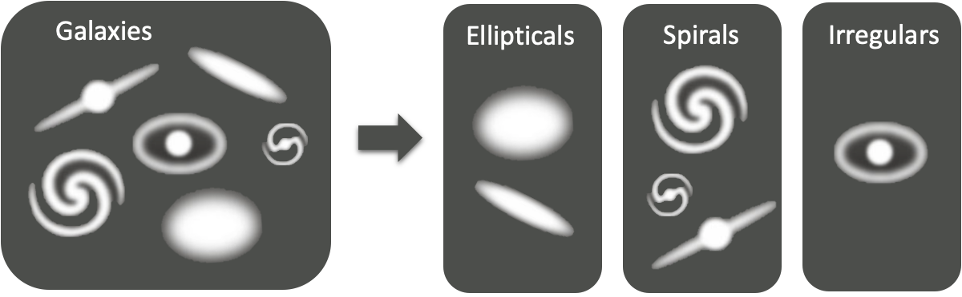
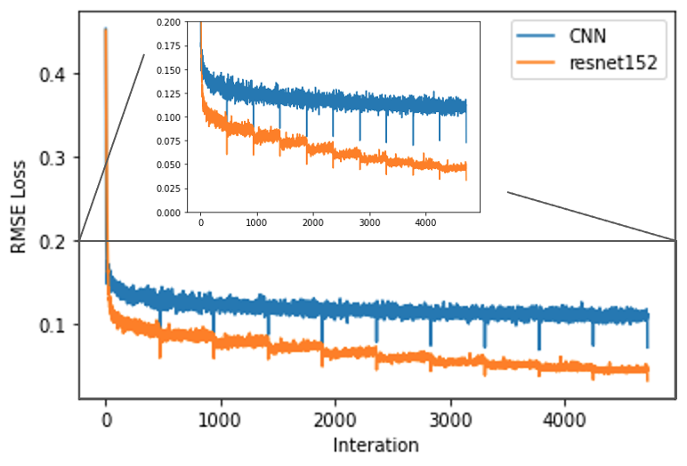
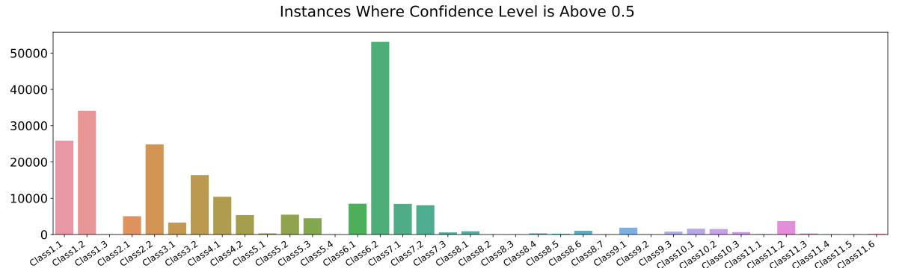

Classify the morphologies of galaxies in our Universe
Chiao Hsiao, Sheng Chieh Lin, Chia-Lin Ko
Introduction
Methodology and Results
Discussion and Conclusion
Galaxies come in different shapes, sizes, and ages: from beautiful spirals (like our Milky Way) to huge ellipticals. To understand how these morphologies of galaxies relate to their underlying physics, galaxies morphologies classification is a crucial step.
However, it is unlikely to manually classify millions of galaxies observed by modern sky surveys.
Hence, our goal is to help astronomers automatically classify galaxies by building a machine learning model from analysing manually classified galaxy images.
Data Pre-processing
To make the training more efficient and avoid the possible confusion from irrelevant edged objects, we decide to crop the image. The images are cropped from 424x424 pixels to central 130x130 pixels, and resized to 64x64 pixels for training.
Model Performance
Operation process chart:
We use Root-Mean-Square Error as loss function to show model’s performance. We achieve almost 81% accuracy by using the ResNet 152 Model, which is including 515 layers, for 10 epochs with 0.0001 learning rate. The plot below show the RMSE loss of different neural network architectures.
We run 10 epoch for our training. In epoch 1, the loss of all models drop rapidly. After epoch 2, the CNN model hit a plateau and hardly reduce the loss, while the loss of ResNet18 and ResNet152 model is still decreasing and reach the accuracy of 82.6%.
Accuracy: If l Prediction-True_Label l< 0.01, defined it as a correct class, then divide the number of correct classes by 37 classes.
Due to the huge amount of our data, it takes too much time for file input and output using colab pro GPU. Although the training time on GPU is less, the total processed efficiency may not be better than processed in CPU.
In our training, using ResNet model can train deppeer and have better performance than using CNN model.
Dataset
The original data is from Galaxy zoo data [1]
The total number of pictures is up to 60,000 RGB images with an original size of 424x424.
The galaxies are classified into 37 different categories
The values of labels in each class represent the probability from human classification.
Model | Kaggle score | Kaggle ranking
Simple CNN (epoch10) | 0.11392 | #94
VGG16 (epoch5) | 0.09366 | #31
ResNet18 (epoch10) | 0.08989 | #22
ResNet152 (epoch10) | 0.0899 | #22
References
[1] Galaxy Zoo Data, accessed 6 June 2021, <https://dat a.galaxyzoo.org/>
[2] Galaxy Zoo - The Galaxy Challenge, accessed 6 June 2021, <https://www.kaggle.com/c/galaxy-zoo-the-galaxy -challenge/>
*Rank #1 score: 0.07491
*Total competitors: 326
Notes:
[Introduction]
Galaxies come in different shapes, sizes, and ages: from beautiful spirals (like our Milky Way) to huge ellipticals. To understand how these morphologies of galaxies relate to their underlying physics, galaxies need to be classified. Thus galaxy morphology classification is a crucial step to understanding how galaxies form and evolve.

Slide 2
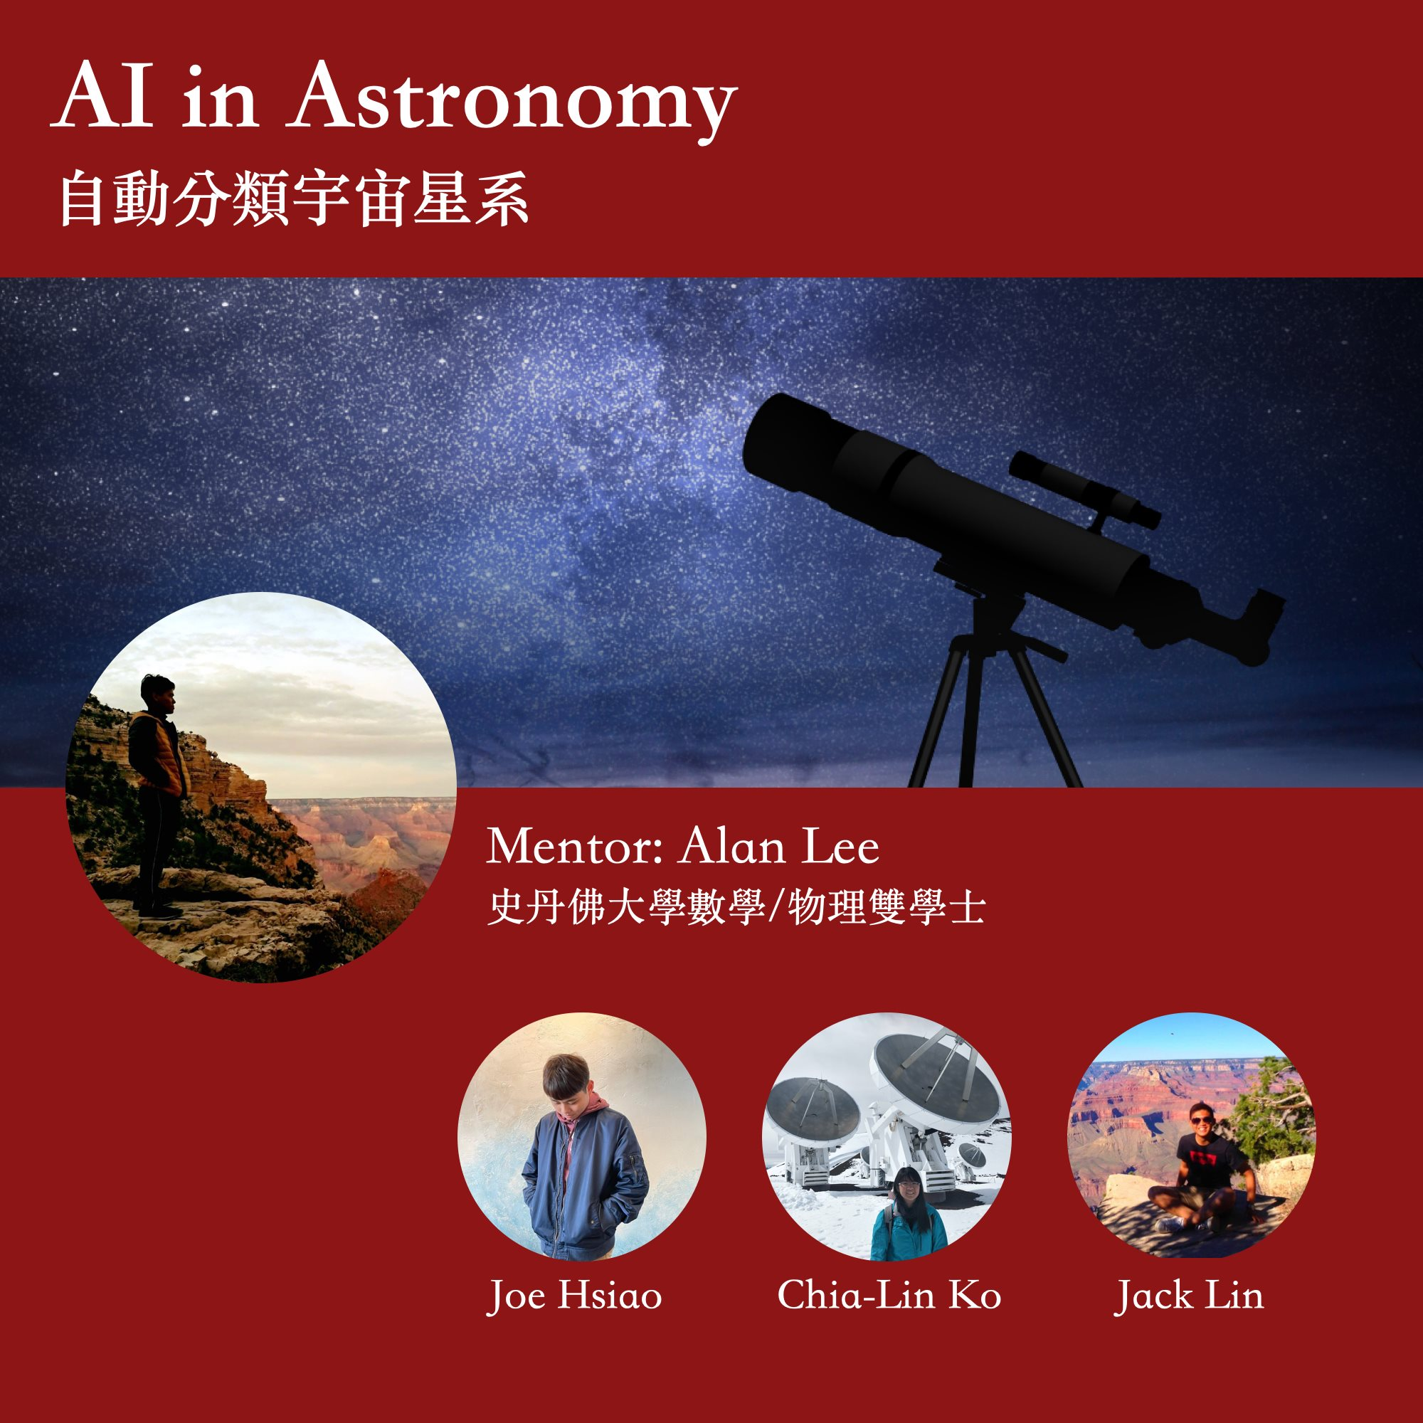
Notes:
哈囉大家好、我們今天要跟大家分享的是AI在天文上的應用
我們的成員有Joe, Jack還有我是+0
我們的mentor是Alan

Slide 3
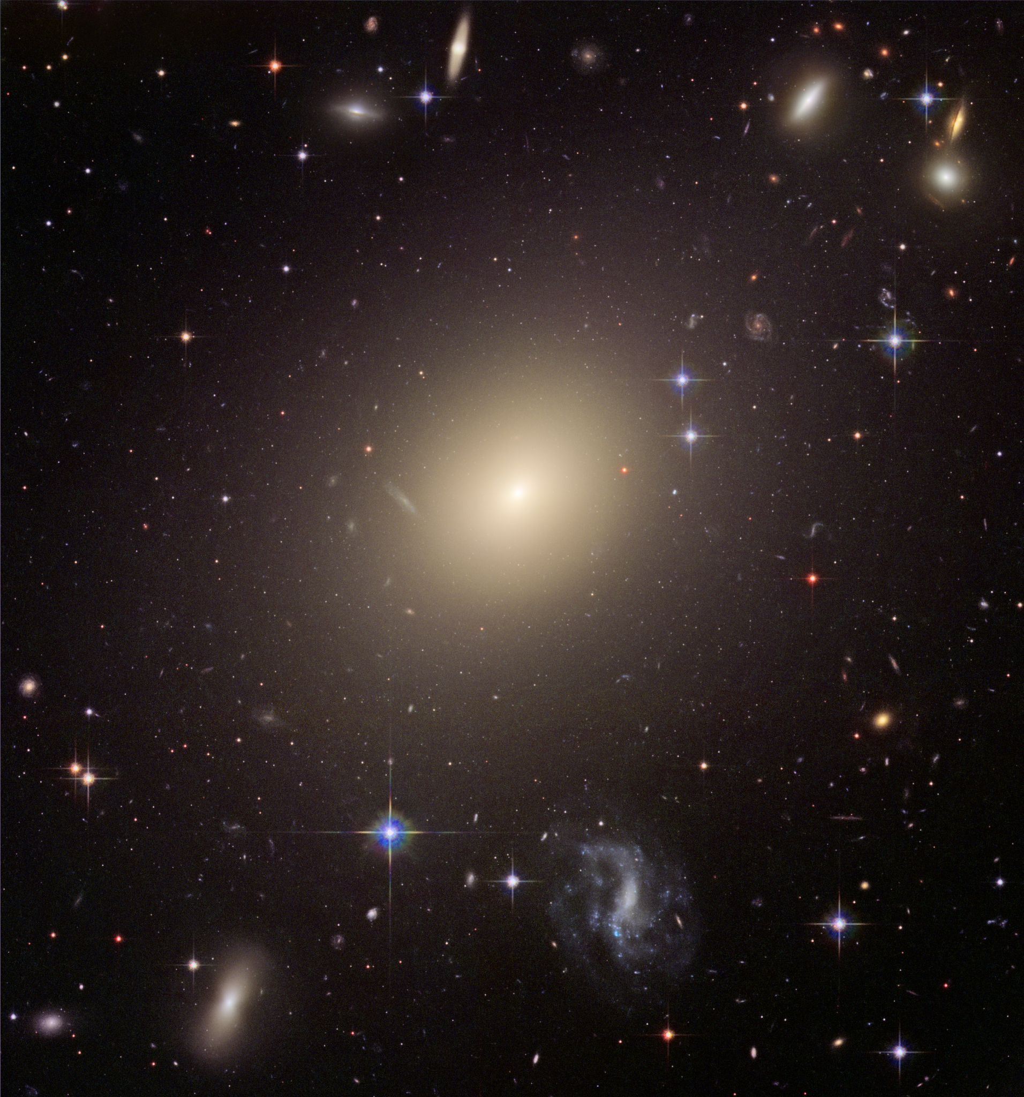
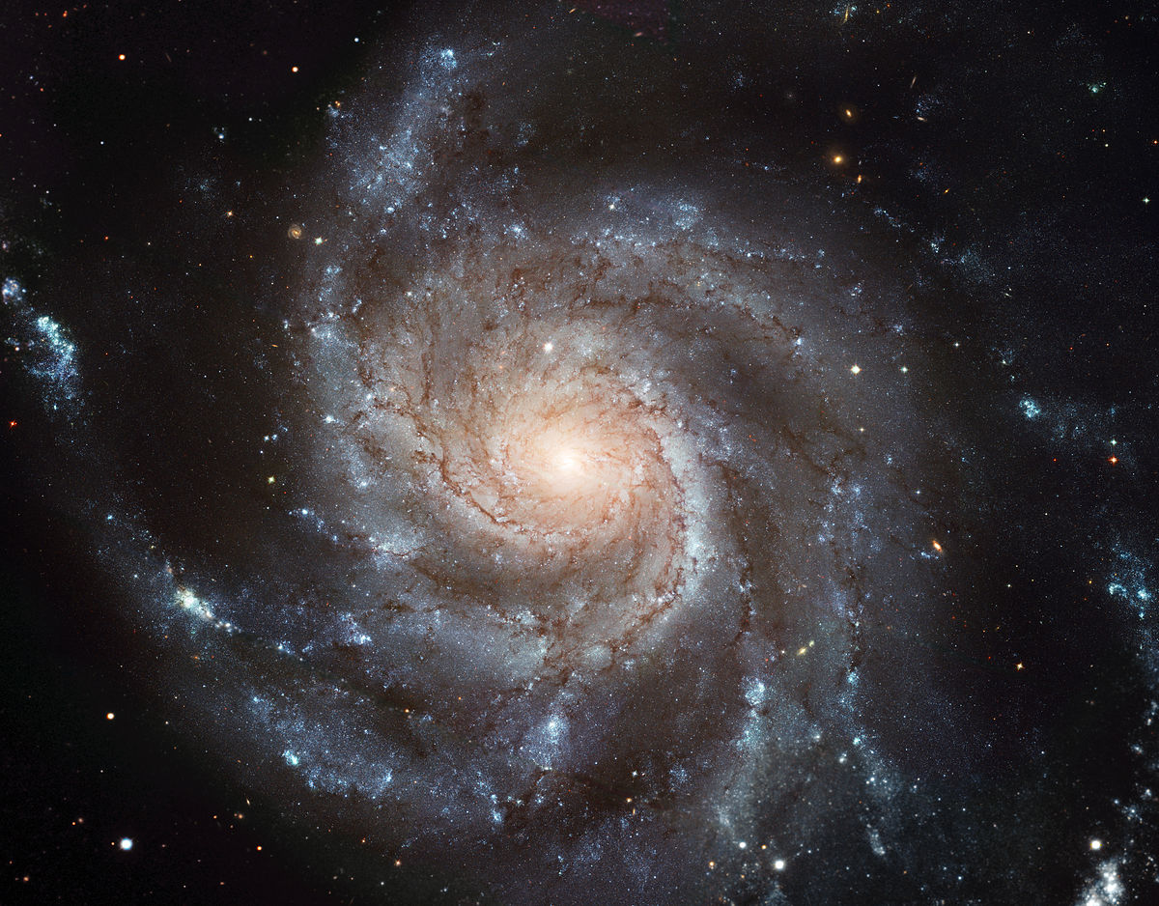
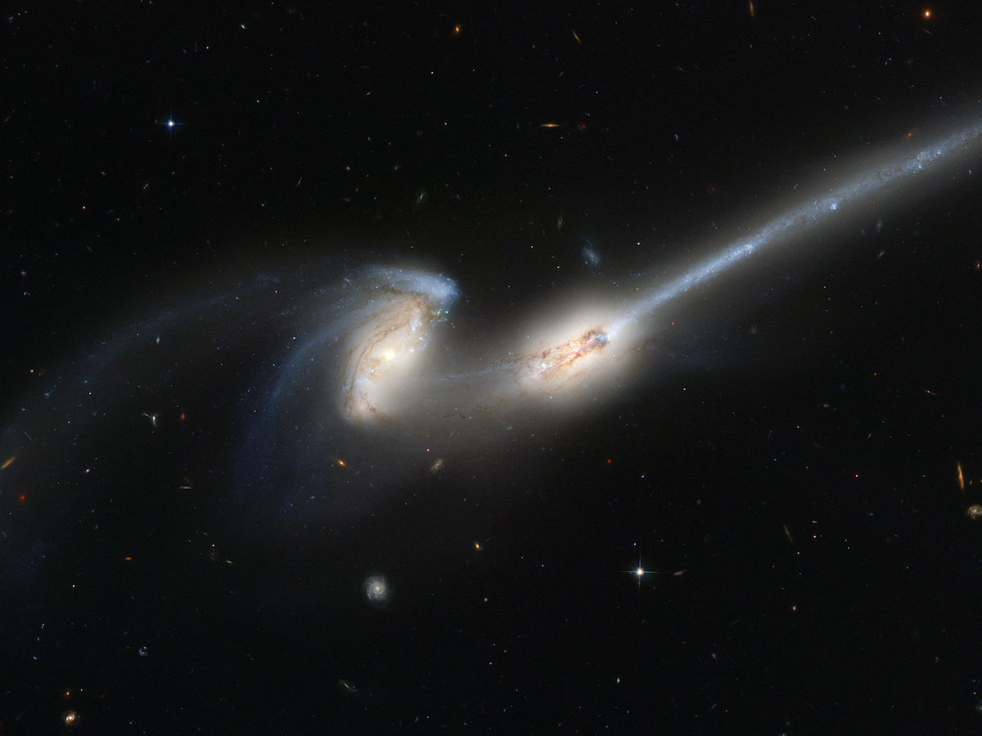
Classify the morphologies of galaxies in our Universe
Motivation
Curiosity!
Galaxies morphologies classification
-> How galaxies form and evolved?
Save PhD students!!!
machining learning: automatically classify galaxies
Notes:
我們的題目是：星系在型態上分類
想必大家或多或少都有聽過
光頭王上太空、 spaceX 發射火箭等等的新聞，
這都代表了我們對於宇宙、銀河系、地球之外的星系是非常好奇的，
那如果想要瞭解星系是怎麼形成和演化的話，
知道這些星系的型態樣貌，然後去分類他們，
就會是非常重要的一環
星系在視覺上的型態主要可以分為三類，
第一類是橢圓的星系(向左邊的這張圖)
第二類是螺旋（就像我們的銀河系一樣會有懸臂的特征）
剩下的第三類就是不規則的星系
而各個類別都還可以有更細的分類
早起星系的分類是靠天文學家，和研究生（就是所謂的高級勞工)，
人工看一個個星系的照片，然後去做分類
但隨著科技進步、望遠鏡效能的提升，我們現在可以觀測到數百萬個以上的星系
在有這麼多星系資料的情況下，利用人工是不太可能的一件事，
所以我們希望可以利用machine learning做出一個模型，來自動的分類這些星系的型態，
在探索宇宙的同時，拯救我們辛苦的研究生

Slide 4
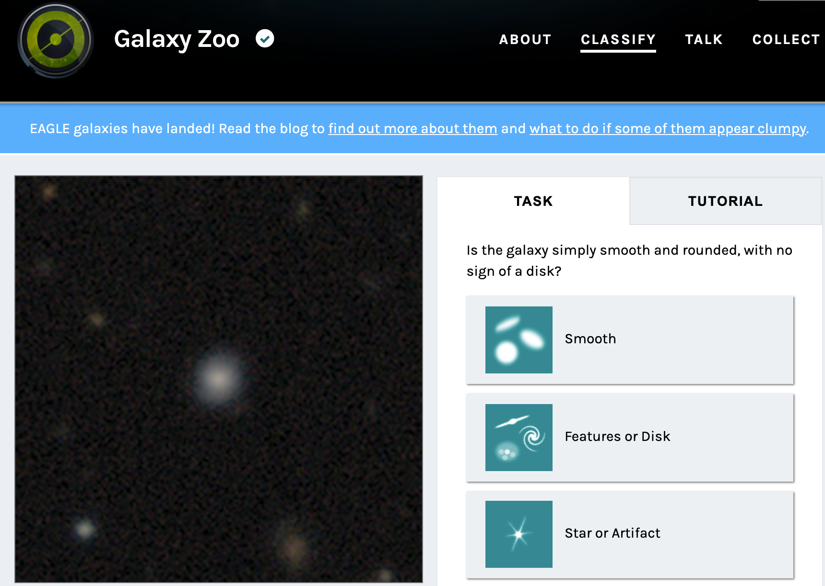
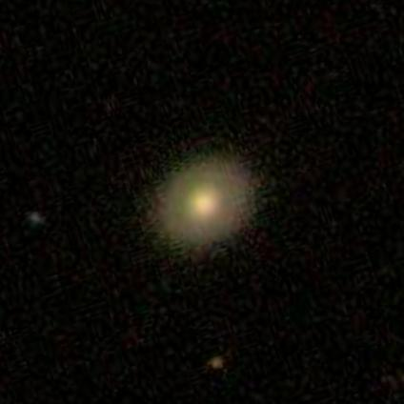
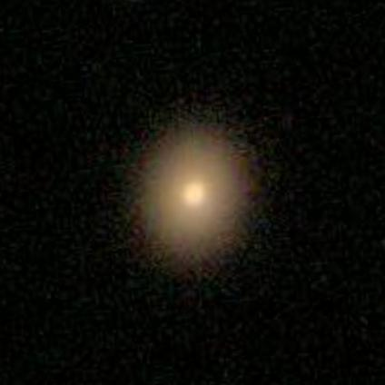
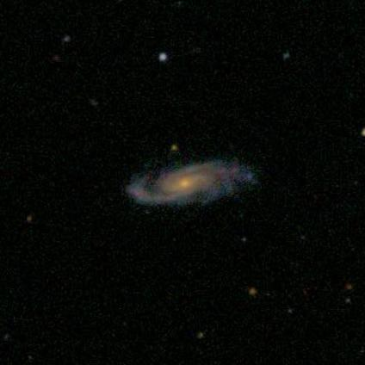
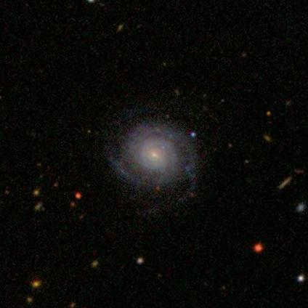
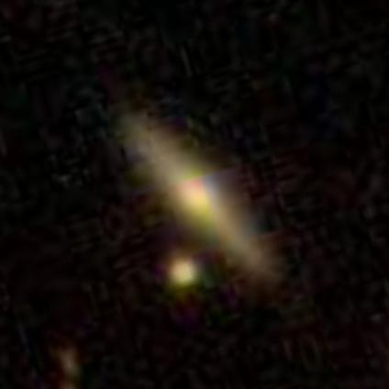
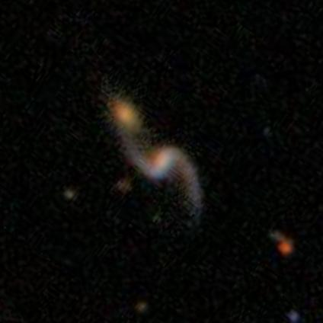
Data: Galaxy Zoo
Total number of RGB images (～2GB):
～60000 (Training data) + 80000 (Test data)
Notes:
這個project其實也是Kaggle上的一個競賽，
我們的資料也上從Kaggle取得的
有6萬多筆訓練的資料和
7萬多筆測試我們模型好不好的資料，
總共的大小有快2GB
而Kaggle上的這些資料，其實是從一個叫Galaxy zoo 星系動物園的project來
這個計畫是天文學家把星系的影像公開的放到網路上，
讓社會大眾藉由回答一系列已經設計好的問題，
幫忙一起分類星系

Slide 5
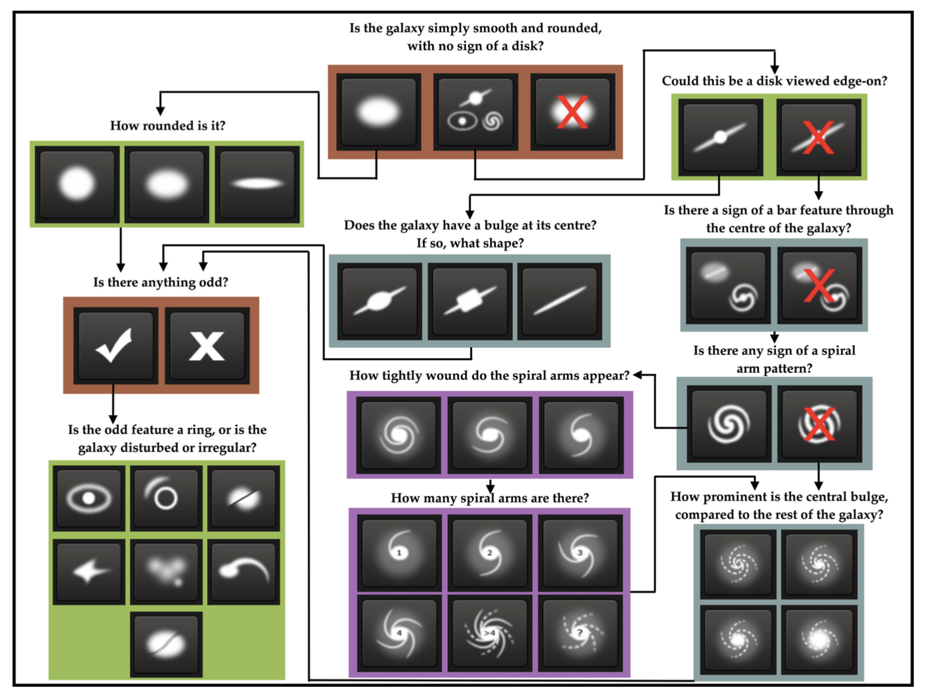
Decision Tree
Notes:
例如：右邊是我們的影像
第一個問題會問你他的形狀是像橢圓、還是有一些像螺旋特徵，或是不是星系
隨後根據你回答，會有後續不同的問題，有點類似decision tree的概念
例如你回答的是橢圓->他就會繼續問你橢的程度
如果是螺旋->星系懸臂的數量或是懸臂之間彼此鬆緊的程度等等

Slide 6
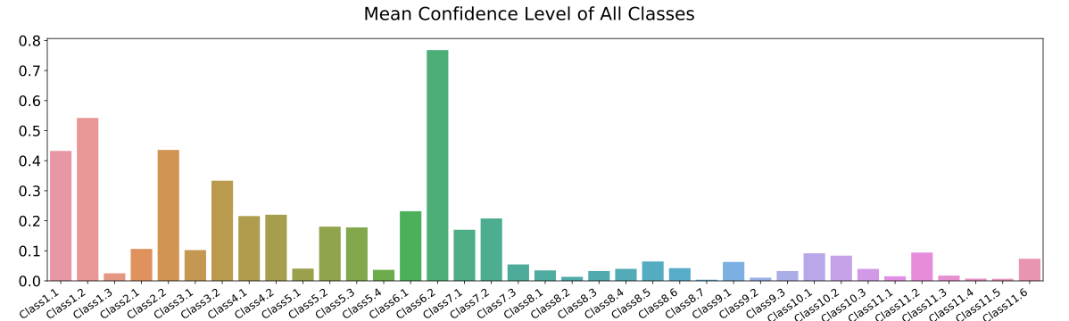
Data
The galaxies are classified into 37 different categories.
The values of labels in each class:
probability from human classification.
Notes:
每個星系會被問4-9個不同的問題，所以每個星系也會分類到不只一個的類別，
總共會有37個類別
這是跟一般所想像的分類問題 貓、狗 每一個圖片只有一個類別 不太’一樣的地方
而且我們每一個星系經過很多不同人分類，來降低主觀判斷的一些誤差
所以我最要分析的時候是
這些星系屬於這些37個類別的一個機率
這就是我們data的部分
那我們的資料的處理和結果就交由Jack來介紹

Slide 7
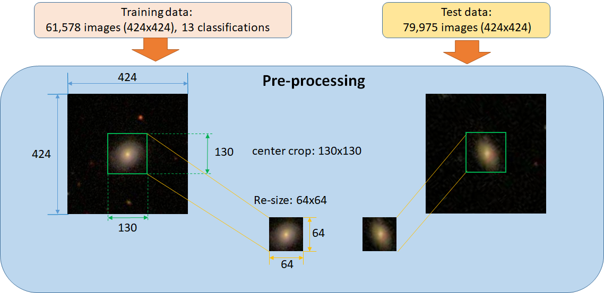
Data Pre-processing
Reduce image size from 14KB(424x424) to 2KB(64x64)
Reduce noise
Focus on target
Adjust data size for CNN(64x64)
Noise
Target

Slide 8
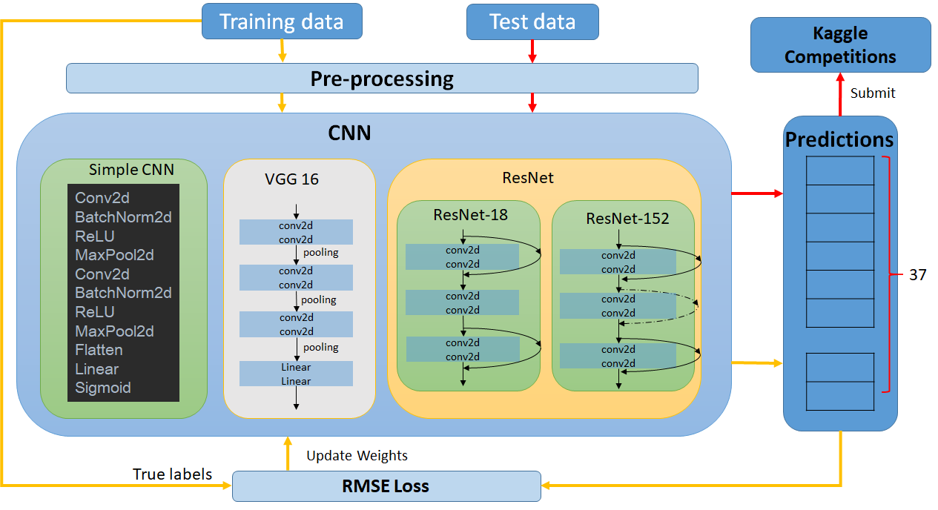
Operation Process Chart
 | layers
Simple CNN | 11
VGG16 | 40
ResNet18 | 69
ResNet152 | 515

Slide 9
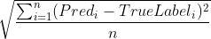
Loss function
Root-Mean-Square Error(RMSE) Loss
What’s different from normal classification loss?
Normal classification problem True label
Galaxy classification problem True label
Class 1 | Class 2 | Class 3 | Class 3 | Class 4 | ... | Class 37
0 | 0 | 1 | 0 | 0 | ... | 0
one-hot vector
correct class
Class 1 | Class 2 | Class 3 | Class 3 | Class 4 | ... | Class 37
0.383147 | 0.616853 | 0 | 0 | 0.616853 | ... | 0.03541
37 Probabilities
variables

Slide 10
MSE Loss & Each Model’s Performance
*Rank #1 score: 0.07491
*Total competitors: 326
Model | Layers | Training time | Kaggle score | Kaggle ranking
Simple CNN (epoch10) | 11 | 6 H 40 Mins | 0.11392 | #94
VGG16 (epoch5) | 40 | 7.5 H* | 0.09366 | #31
ResNet18 (epoch10) | 69 | 16 H 45 Mins | 0.08989 | #22
ResNet152 (epoch10) | 515 | 18 H 15 Mins | 0.0899 | #22
Iteration

Slide 11
Accuracy
How to obtain our accuracy?
If l Prediction-True_Label l < 0.01, we define this class as correct. Then, we divide the number of correct classes by 37 classes.
Different model’s accuracy performance:
Model | Layers | Number of Correct Classes | Accuracy (For total 37 Classes)
Simple CNN (epoch10) | 11 | 28.87 | 78%
VGG16 (epoch5) | 40 | 30.1 | 81.3%
ResNet152 (epoch10) | 515 | 30.57 | 82.6%

Slide 12

Other Discussion & Conclusion
Due to the huge amount of our data, it takes too much time for file input and output using colab pro GPU. Although the training time on GPU is less, the total processed efficiency may not be better than processed in CPU.
In our training, using ResNet model can train deppeer and have better performance than using CNN model.

Slide 13




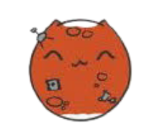

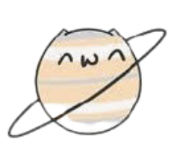
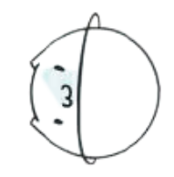


AI in Astronomy

Slide 14
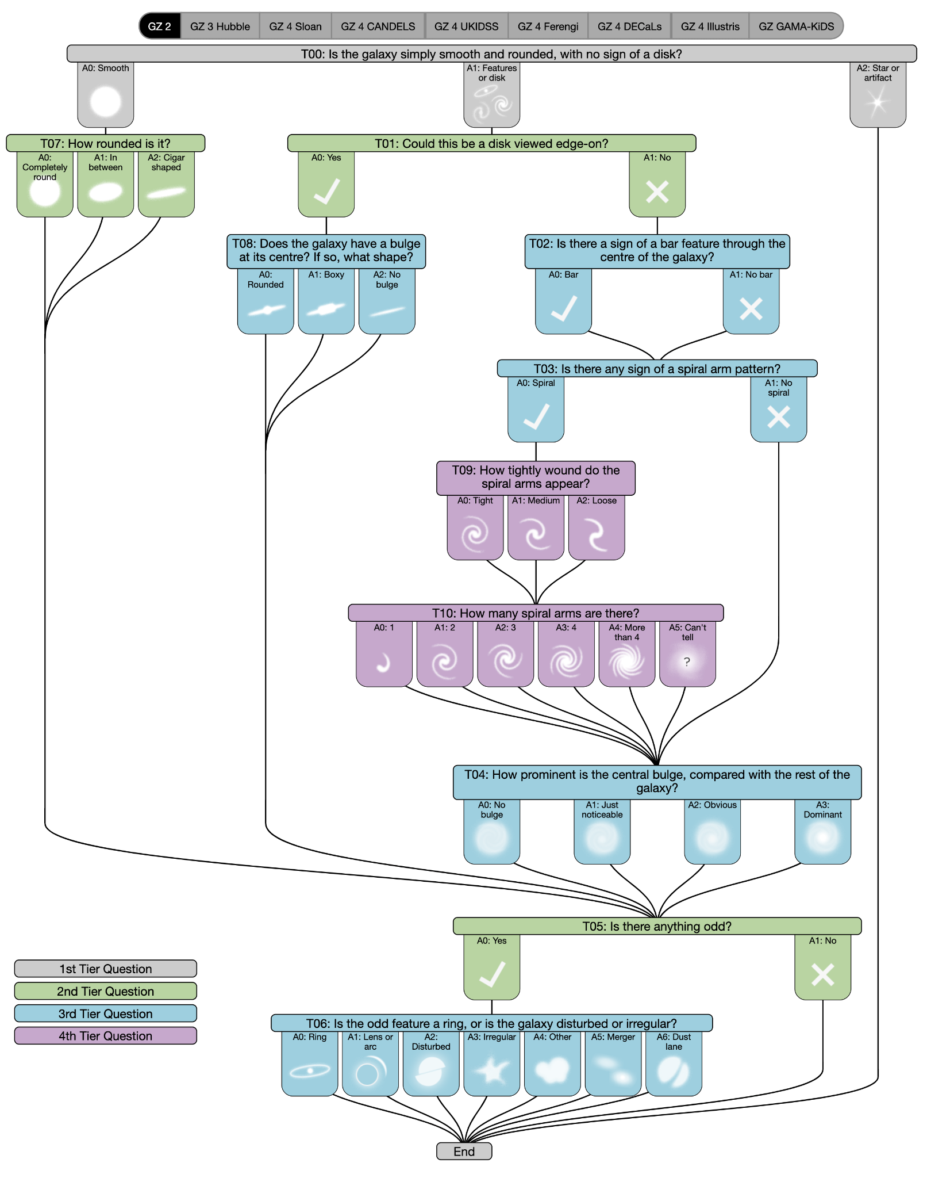
Decision Tree

Slide 15
Classification’s types & Mean Confidence Level of all Classes

